Slide 1
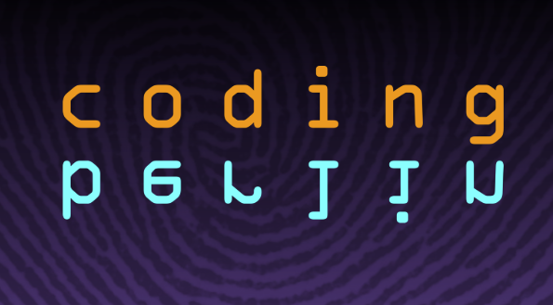
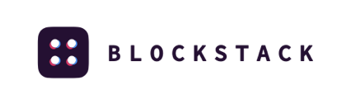
Decentralised identities, storage, and applications with Blockstack
Yann-Aël Le Borgne
24/01/2019

Slide 2
Would you like
to use Internet applications and have full control on your data and identity?
To decide what your identity is when you connect to an app?
To be able to switch from an application provider to another without losing all of your data?
For apps such as collaborative document edition, social network, chat, picture sharing, and so on

Slide 3
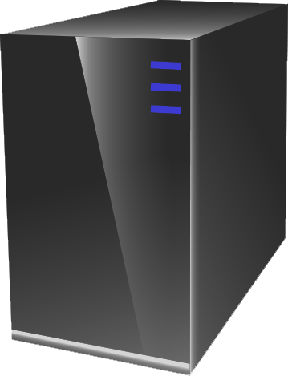
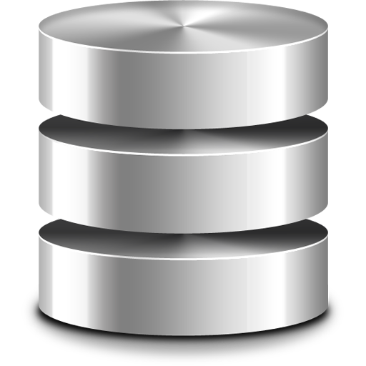


What Problems Are We Trying to Solve?
Cert. Authority
Your Data
Get certs,
Check certs
You
DNS lookup
DNS
Sign-in
Load data

Slide 4
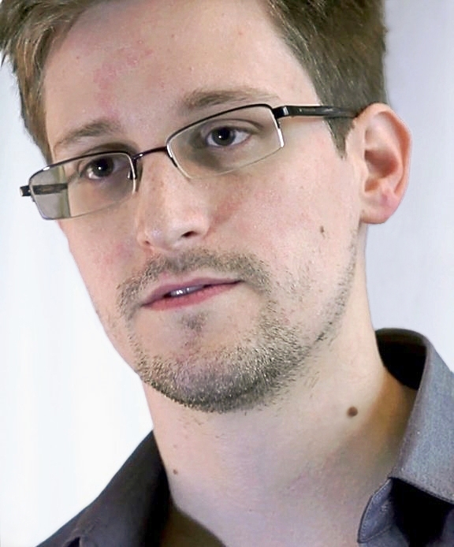
What Problems Are We Trying to Solve?
Single points of failure
You are the product
“Don’t be evil” is not good enough

Slide 5
‘Sign-in with …’ , side story
Even if I do not sign in with Facebook, what does Facebook know about the apps I use?
A lot!
Investigation Q3/Q4 2018: Privacy international
Check video on 35C3 website
Full report on their website
Example: Spotify - https://privacyinternational.org/node/2498
https://media.ccc.de/v/35c3-9941-how_facebook_tracks_you_on_android
https://privacyinternational.org/campaigns/investigating-apps-interactions-facebook-android

Slide 6
What Problems Are We Trying to Solve?
Build “can’t be evil” applications
Users own their identities
Users own their data
Apps host neither
Can we build Web apps this way? Use Blockstack!

Slide 7
What is Blockstack?
Shared blockchain
You
Others
Pubkey lookup
Pubkey lookup,
Data lookup
Your Data
Store signed encrypted data
Load, verify, & decrypt data

Slide 8
What is Blockstack?
A new Internet for decentralized applications
Provides core services
Identity
Storage
Payments
Uses a blockchain to bootstrap

Slide 9
Blockstack Architecture
Cloud storage
Cloud storage
Cloud storage
Cloud storage
Storage layer
Gaia
node
Gaia
node
Gaia
node
routing state
routing state
routing state
routing state
routing state
Identity layer
Name Txn
Name Txn
Name Txn
Name Txn
Name Txn
Name Txn
Name Txn
Name Txn
Blockchain

Slide 10
Blockstack Identity Layer
Naming and PKI on a commodity blockchain
“DNS for People”
Namespaces (TLDs)
Updates, Transfers, Renewals, Revocations
First-come first-serve
Anyone can register a name or namespace

Slide 11
Blockstack Identity Layer
On-chain database log as specially-crafted TXNs
Nodes replay transactions to produce this DB
Solves the key distribution and revocation problem
Name | Public Key Hash | Routing state hash
jude.id | 16EMaNw3pkn... | b6e99200125e...
cicero.res_publica.id | 1EtE77Aa5AA8et... | 7e4ac75f9d79b...

Slide 12
Blockstack Identity Layer
Off-chain routing state (~40Kb/txn)
Pointers to where your app data is hosted
Fully replicated to all nodes via P2P network
$ORIGIN cicero $TTL 3600 _file URI 10 1 "https://gaia.blockstack.org/hub/1EtE77Aa5AA8etzF2irk56vvkS4v7rZ7PE"

Slide 13
Blockstack Storage Layer (Gaia)
Reuses commodity storage systems
Data is signed and encrypted
User chooses which system(s) host their data
Per-app buckets
Per-app private keys

Slide 14
Blockstack Storage Layer (Gaia)
Names resolve to profiles
Profiles resolve to app data
{ … data for Publik … }
Signed by Publik app key
“apps”: { "http://publik.ykliao.com": "https://app.graphitedocs.com": "https://www.stealthy.im":
},
judecnelson.id
{ … data for Graphite … }
Owned by master key
Signed by Graphite app key
Signed by master key
{ … data for Stealthy … }
Signed by Stealthy app key

Slide 15
Blockstack Infrastructure
Anyone can run a Blockstack node
Takes ~10 GB disk, ~200MB RAM
Builds name DB
https://core.blockstack.org
RESTful API endpoint
https://explorer.blockstack.org
Profile explorer

Slide 16
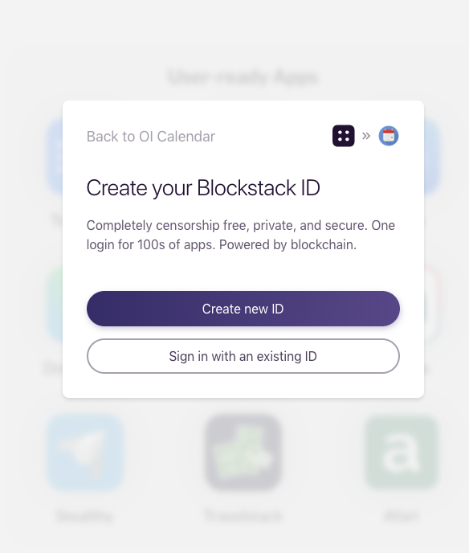
Let us try it
Go to https://browser.blockstack.org
Create your ID

Slide 17
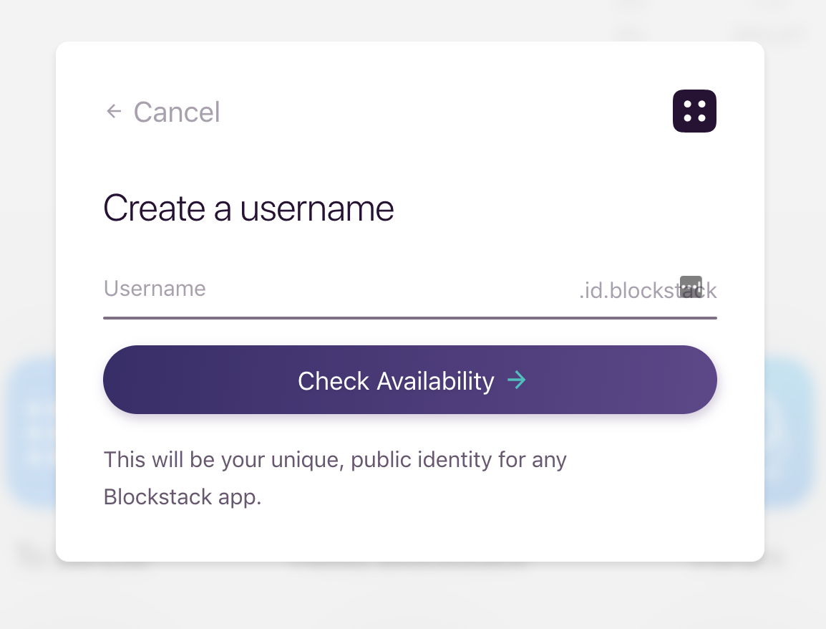
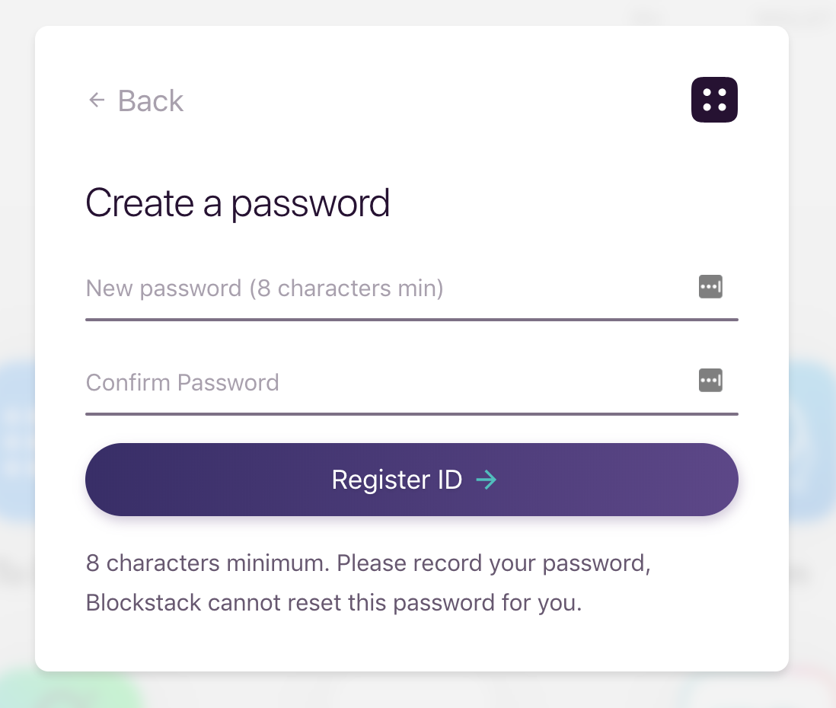
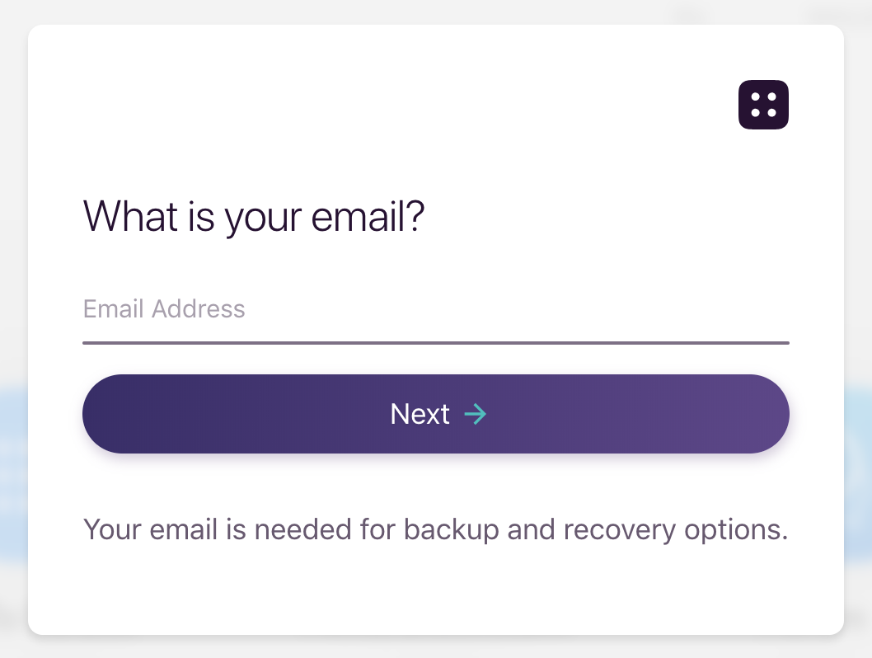
Let us try it
Choose username, password, and enter mail (used only for sending recovery passwords)

Slide 18
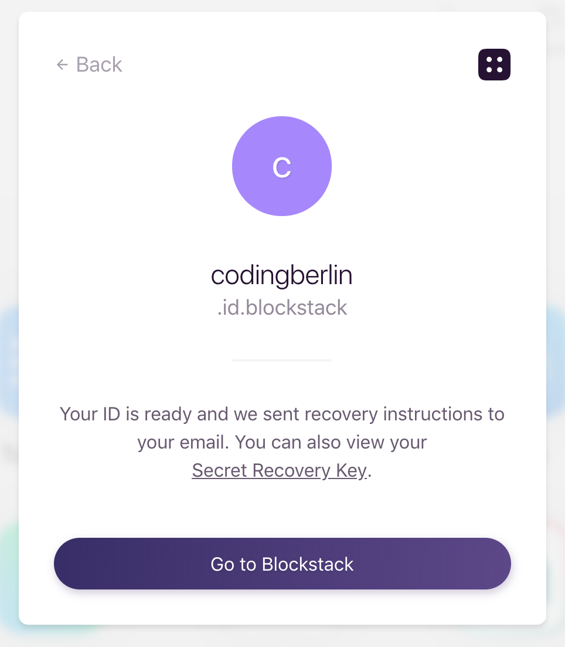
Let us try it
Once your ID is created,
go to Blockstack browser

Slide 19
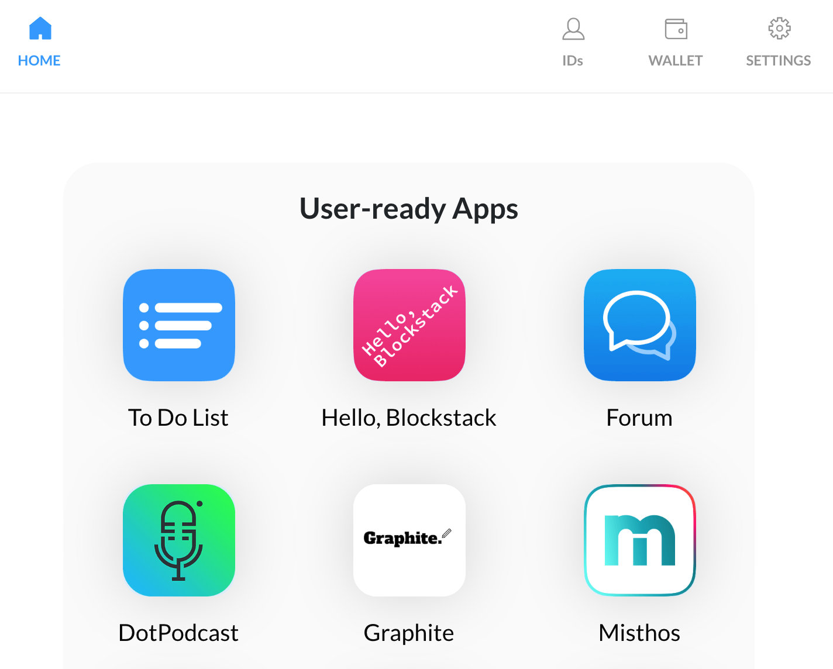
Blockstack browser - Home

Slide 20
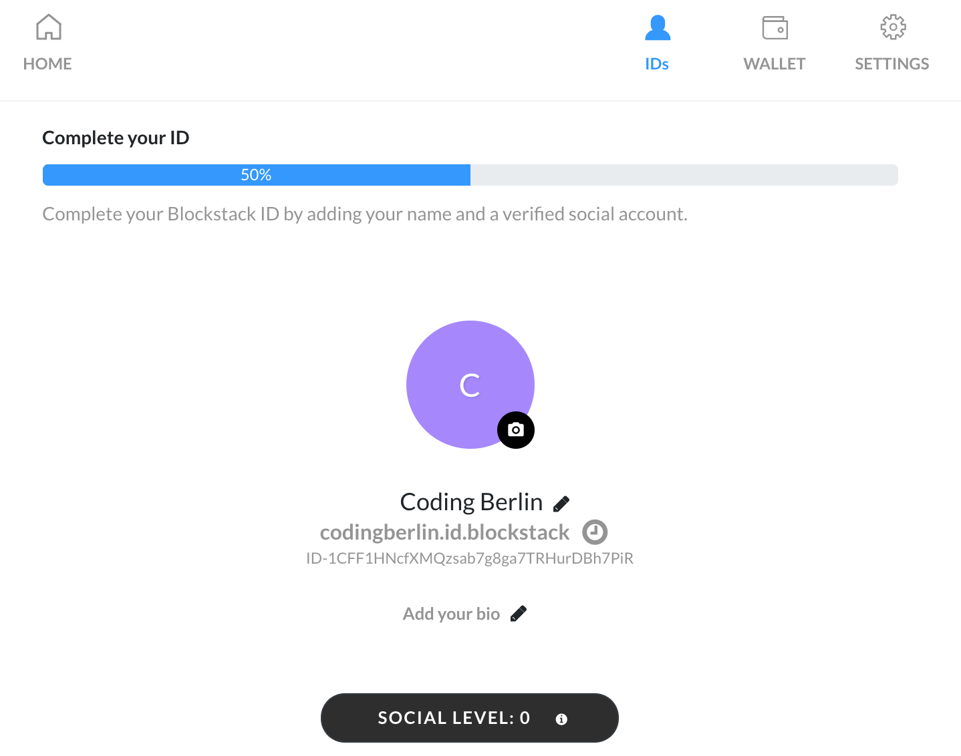
Blockstack browser - ID

Slide 21
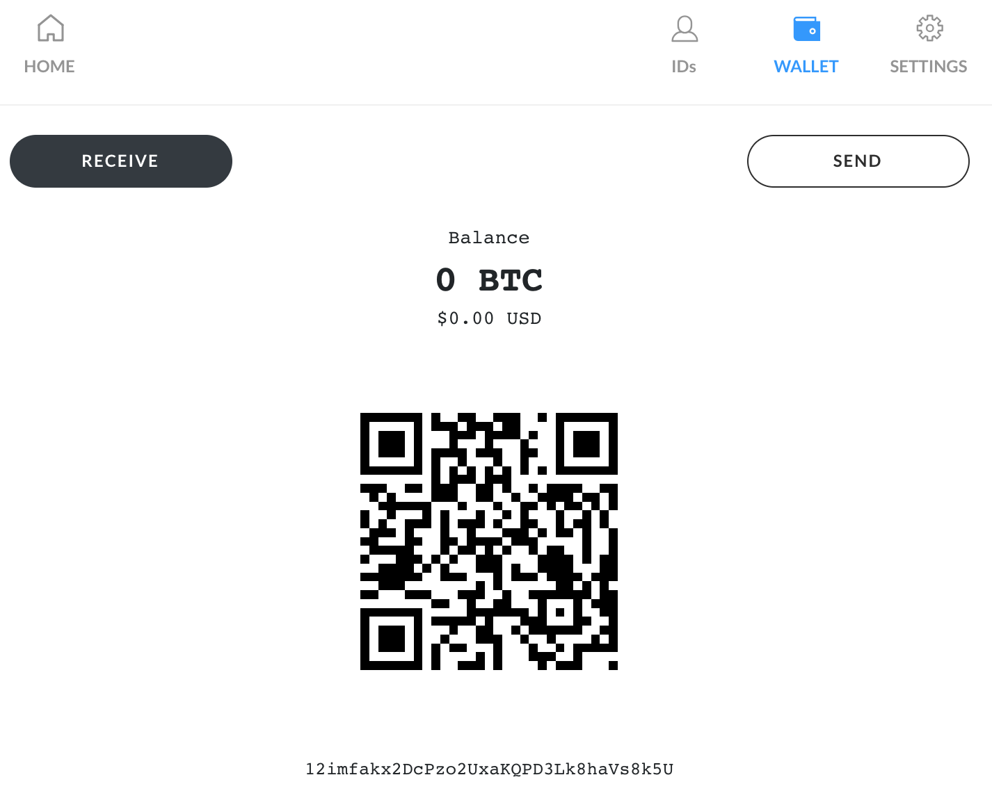
Blockstack browser - Wallet

Slide 22
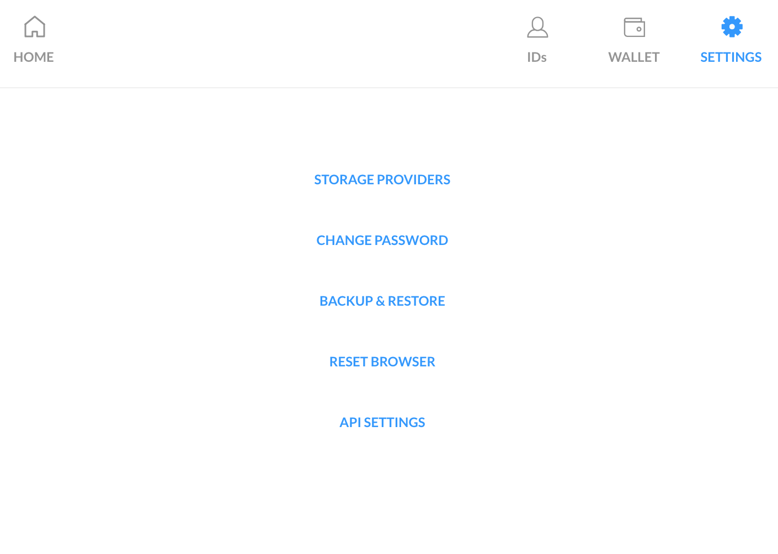
Blockstack browser - Settings

Slide 23
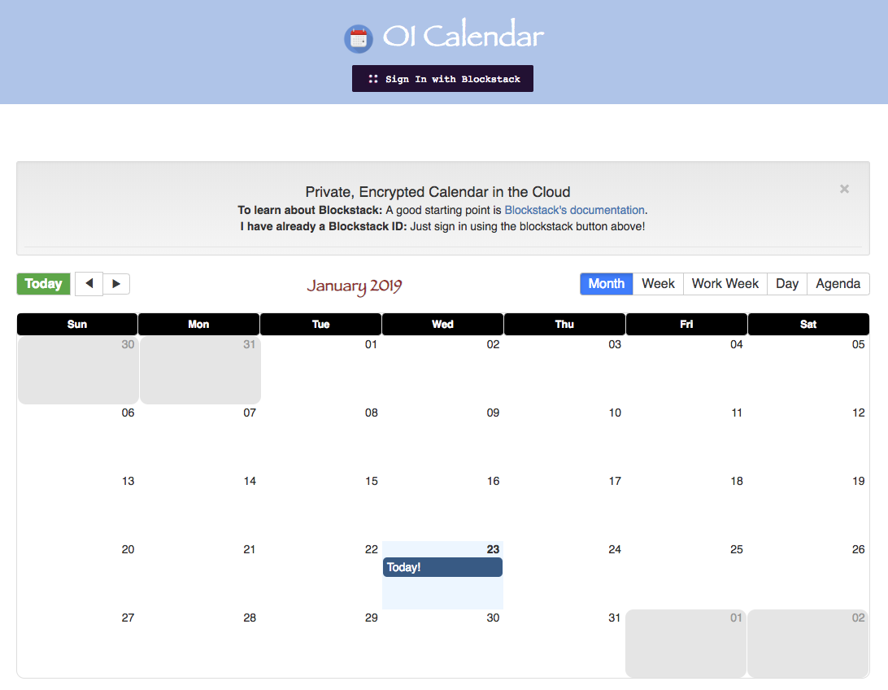
Trying an app: OI Calendar
Go to http://cal.openintents.org

Slide 24
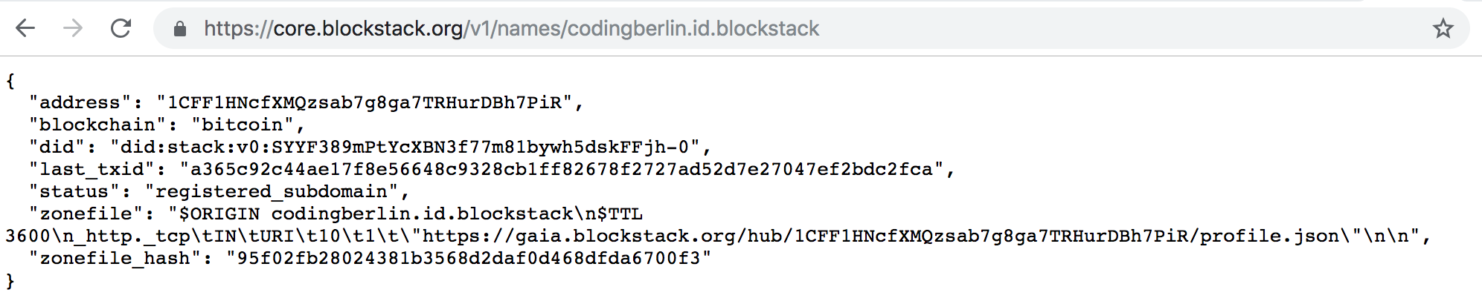
Where is my data?
Use https://core.blockstack.org to query the Blockstack network and retrieve your zonefile
Go to name querying/get name info for your Blockstack ID

Slide 25
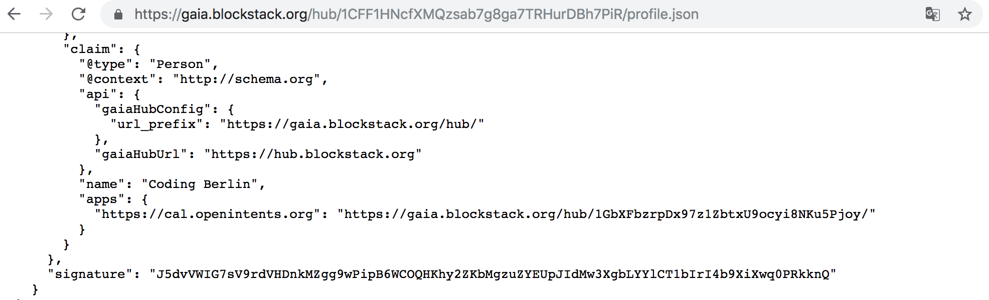
Where is my data?
From the Zonefile file, follow the link to your profile.json

Slide 26
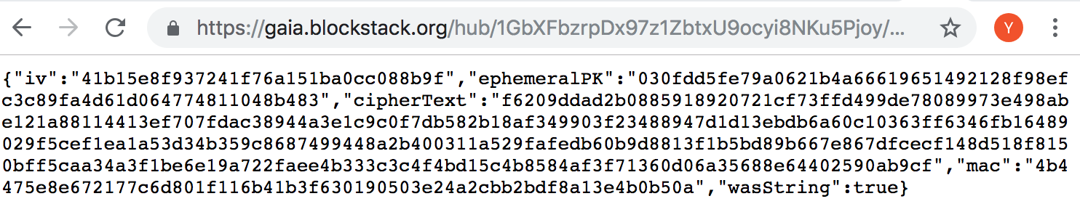
Where is my data?
From the profile.json, follow the URL to app storage
Note: file name is ‘AllEvents’

Slide 27
App development
Blockstack.js : https://blockstack.github.io/blockstack.js
The library takes care of most of the complexity for authentication, profile lookups, storage URL resolution, …
Main functions:
redirectToSignIn(): void
handlePendingSignIn(): Promise(profile)
loadUserData(): profile
lookupProfile(): Promise(profile)
getFile(path, options): Promise(data)
putFile(path, data, options): Promise(bool)

Slide 28
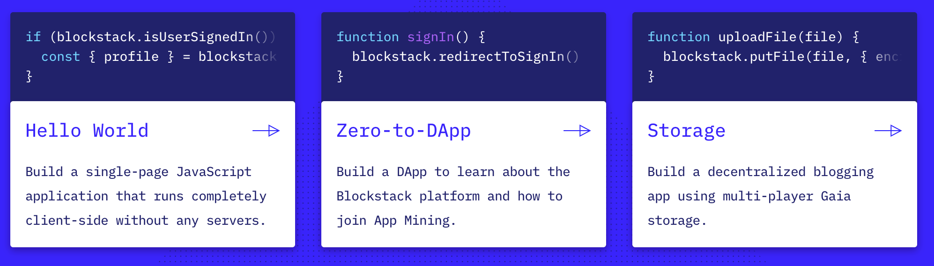
Tutorials
Check https://blockstack.org

Slide 29
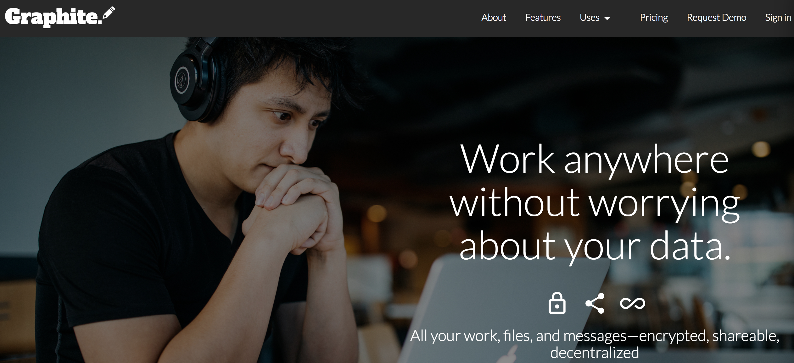
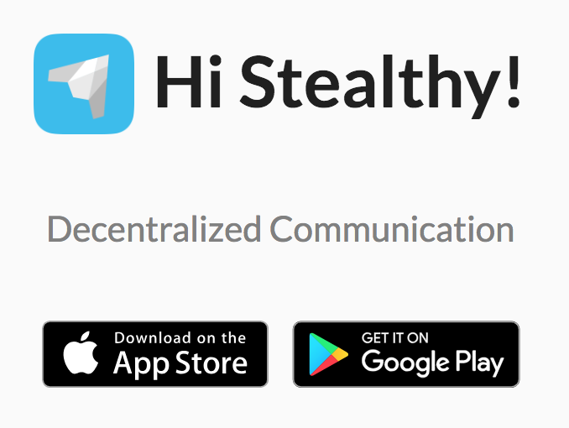
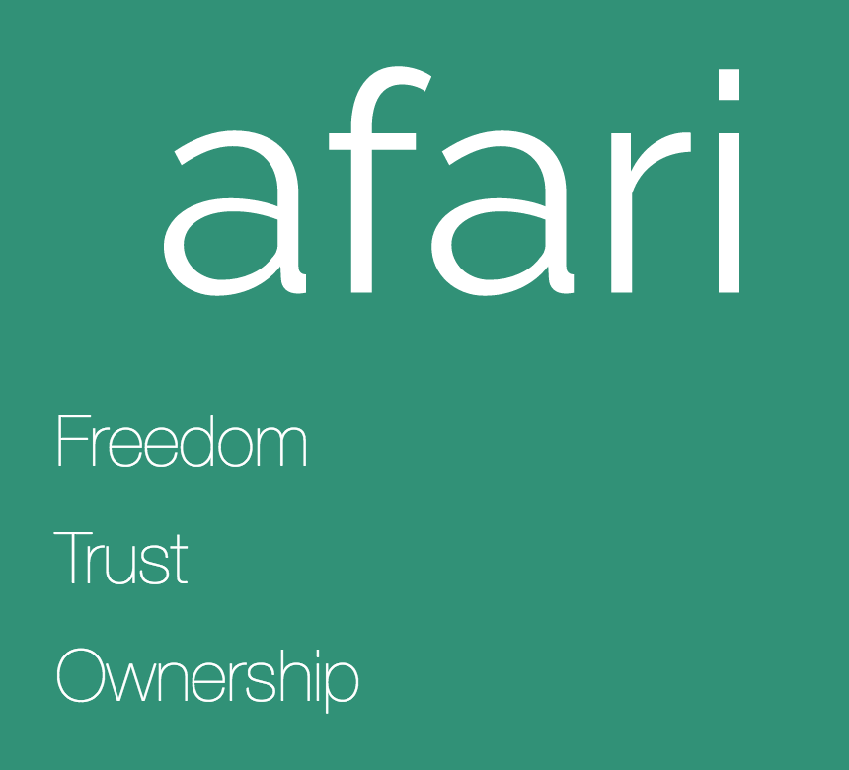
Application ecosystem
Graphite: ‘Google G-Suite’
https://www.graphitedocs.com
Stealthy: ‘Skype’
https://www.stealthy.im
Afari: ‘Facebook’
https://app.afari.io
Blockusign, Misthos, Noteriot, …

Slide 30
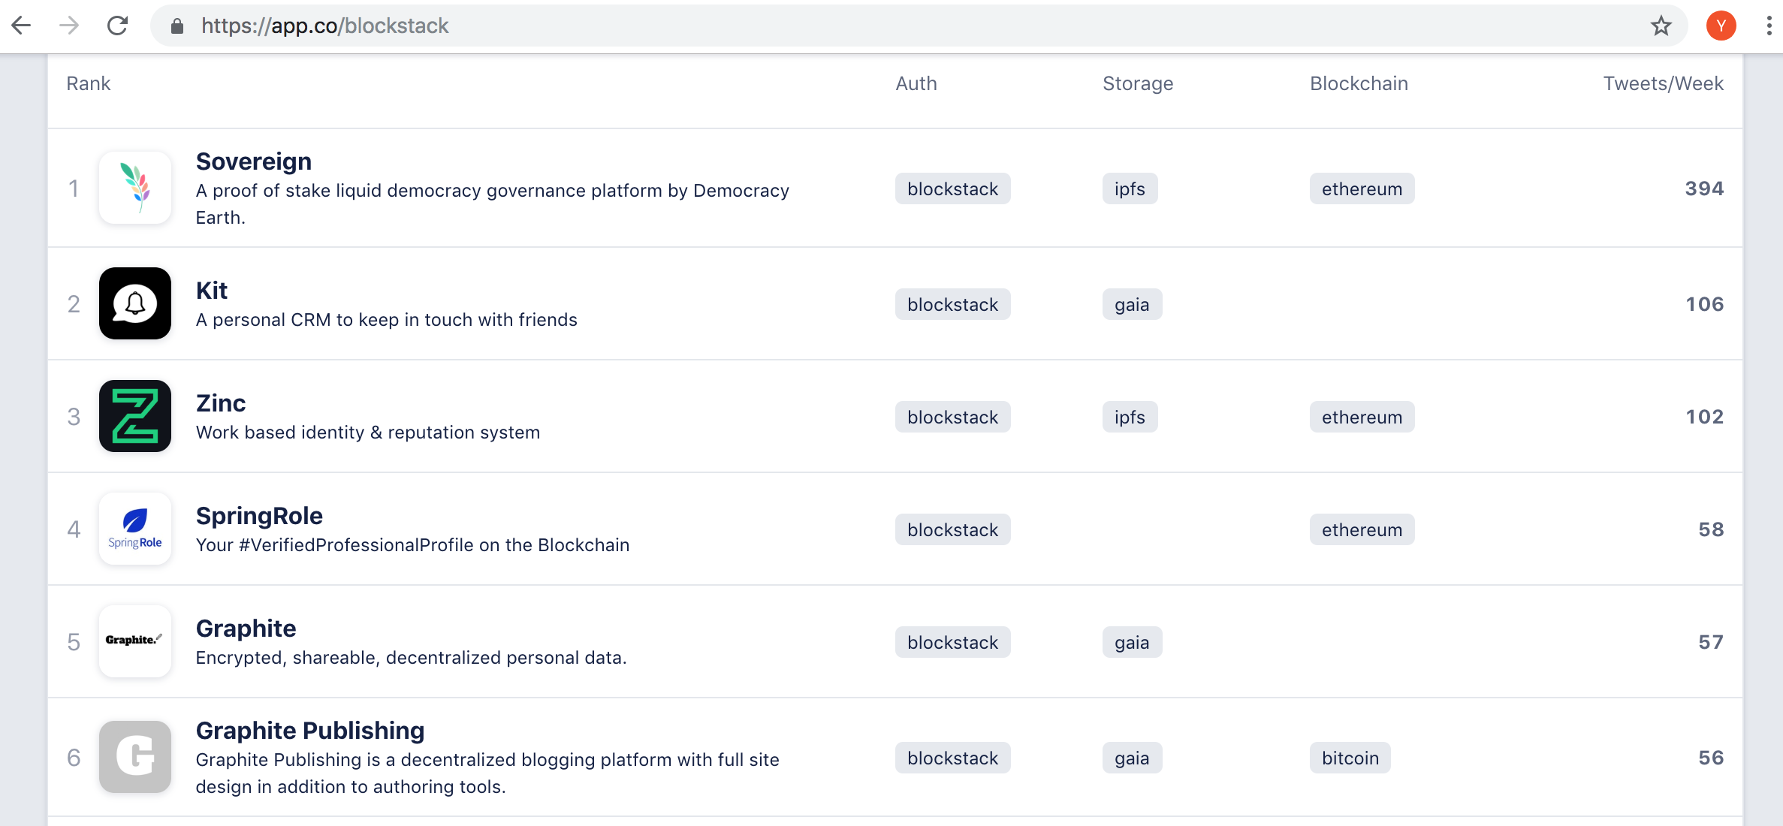
Application ecosystem
https://app.co/blockstack

Slide 31
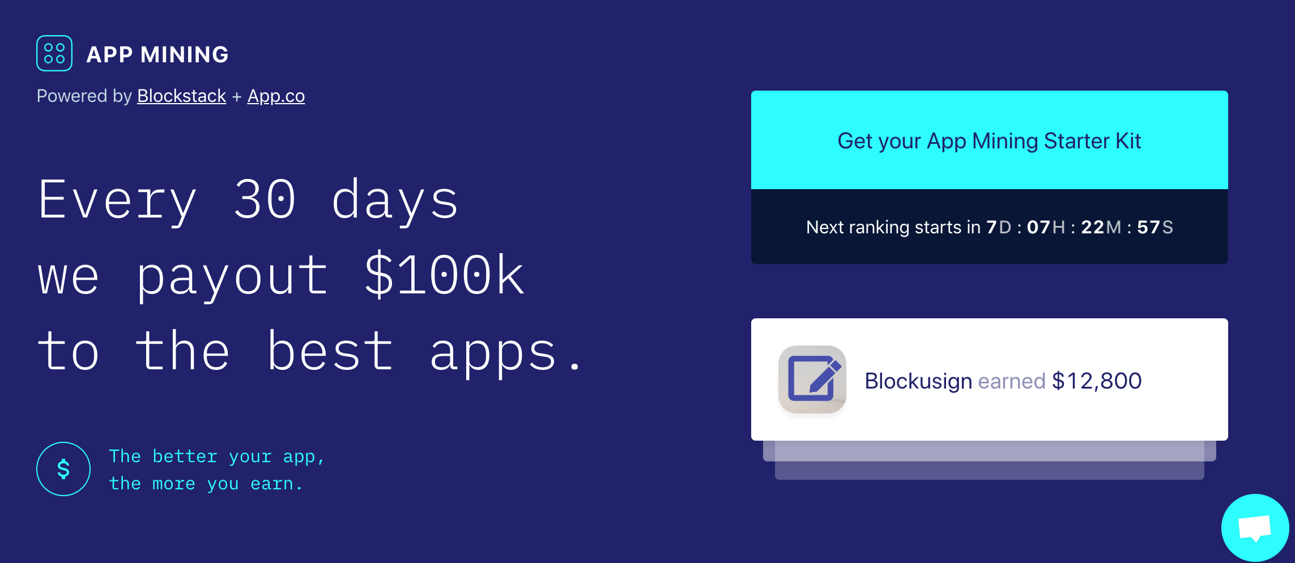
Funding for developers: App mining
https://app.co/mining

Slide 32
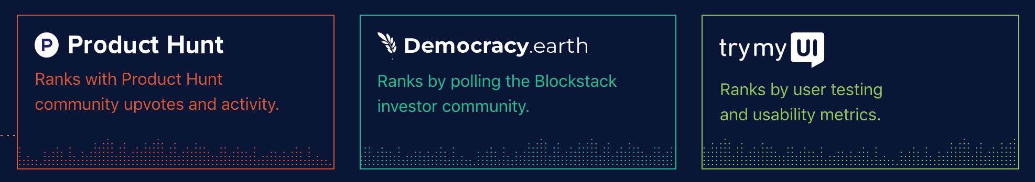
Funding for developers: App mining
https://app.co/mining
Eligibility: Blockstack app that uses decentralized identity and storage
Ranking based on app reviewer scores (Product Hunt, Democracy Earth, TryMyUI)

Slide 33
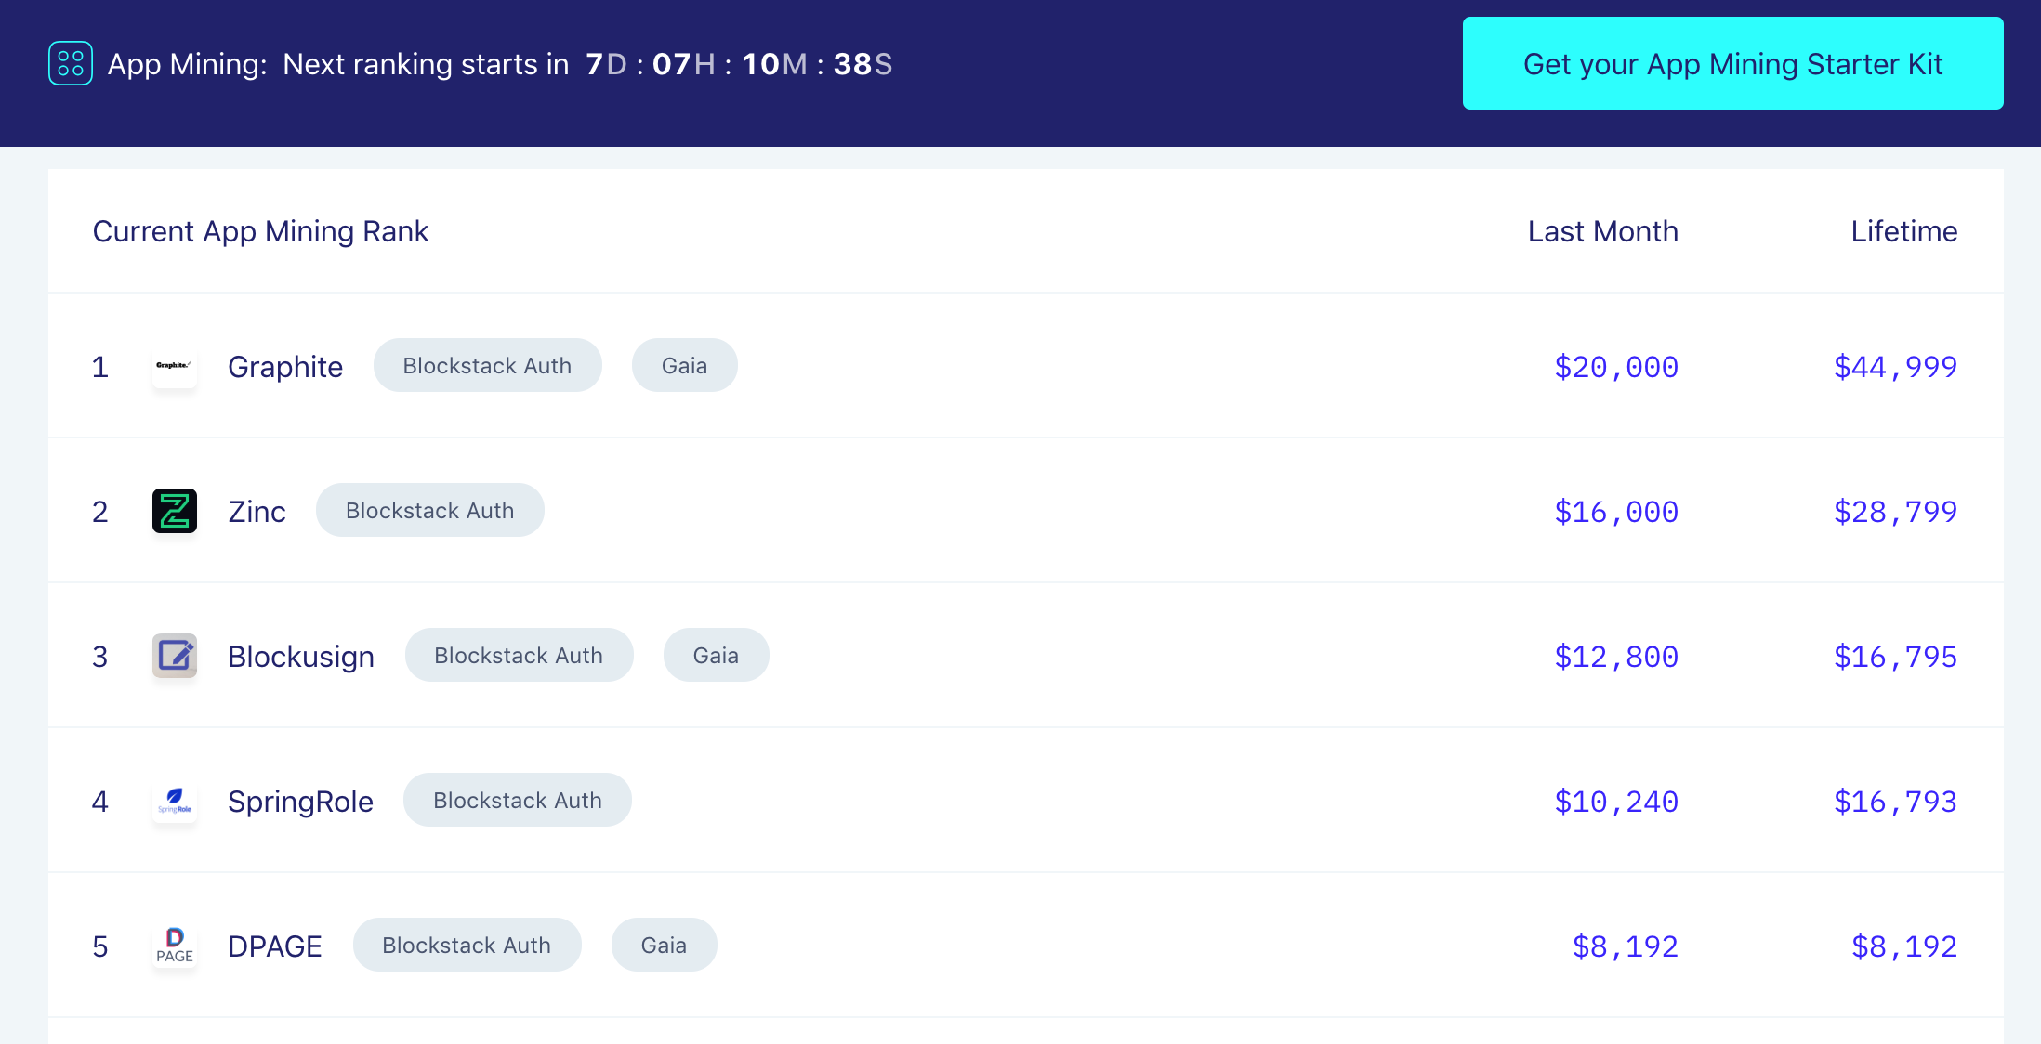
Funding for developers: App mining
https://app.co/mining

Slide 34
How to get started
Zero-to-Dapp tutorial: https://docs.blockstack.org/develop/zero_to_dapp_1.html
Ideas for apps: https://forum.blockstack.org/t/big-list-of-app-ideas
Find help in Blockstack forums, Slack, local communities

Slide 35
Thank You!
https://blockstack.org
https://github.com/blockstack

